Slide 1




01
The Future of Supply Chain Visibility (2026)
5 Breakthrough Technologies Every Supply Chain Leader Must Track
DragonSourcing.com

Slide 2


02
Why Visibility Matters in 2026
  72% of companies say visibility gaps caused delays & cost overruns.
  In 2026, real-time intelligence becomes the new competitive edge.
  These 5 technologies will redefine transparency, control, and speed.

Slide 3
03
AI-Powered Predictive Analytics
What it does:
  Converts historical + real-time data into accurate forecasts.
  Predicts disruptions before they happen.
  Impact:
  Cuts stockouts, prevents supply delays, improves planning accuracy.

Slide 4
04
IoT Sensors & Smart Tracking
What it does:
  Real-time location, temperature, and movement tracking.
  Multi-node visibility from factory to customer.
  Impact:
  Reduces loss, improves traceability, enhances chain-of-custody.

Slide 5
05
Digital Twins
What it does:
  Creates a virtual replica of the entire supply chain.
  Simulates “what-if” scenarios.
Impact:
  Better decision-making, optimized routes, fast disruption recovery.

Slide 6
06
What it does:
  Creates tamper-proof product records.
  Enables transparent supplier & logistics tracking.
Impact:
  Stronger compliance, lower fraud, improved trust across partners.
Blockchain Traceability

Slide 7
07
Autonomous Supply Chain Platforms
What it does:
  Uses AI + automation to manage tasks end-to-end.
  Self-corrects disruptions without human intervention.
Impact:
  Faster cycle times, lower operating costs, 24/7 optimization.

Slide 8

What This Means for 2026
08
  End-to-end visibility will shift from optional to mandatory.
  Companies adopting these technologies will reduce risks by 40–60%.
  The winners in 2026 will be those who can see sooner, act faster, and optimize continuously.

Slide 9
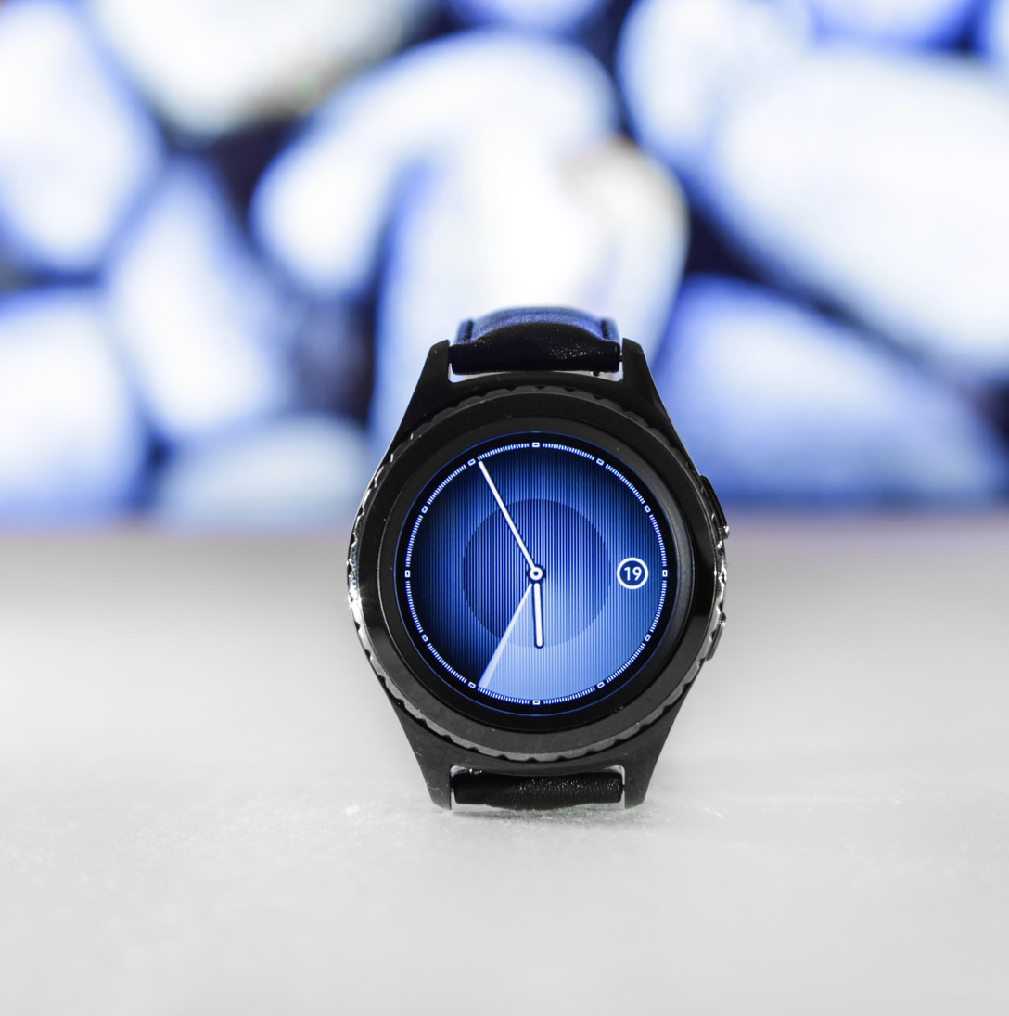
09
Contact Us
01
02
DragonSourcing.com
hello@dragonsourcing.com

